Slide 1

Comparing the transparency of the haptic paddle using different interaction controllers
Physical Human Robot Interaction Specialization Project
Ramon Rohner, Xiaowei Lin
23th December 2021, Zurich
Notes:
Xiaowei

Slide 2

Introduction - Background and Motivation
Background and Motivation
Robotic devices are widely used in neurological rehabilitation
Different impairment levels of patients
Providing the right amount of support and challenge
Impedance control(detailed block diagrams in the backup slides)
open-loop impedance control
impedance control with model feedforward
Impedance control with force feedback
Low impedance
Almost no resistance to motion (Z → 0)
High impedance
Almost complete resistance to motion (Z → ∞)
pHRI Lecture 10
Notes:
Xiaowei
Robotic devices are widely used in rehabilitation applications after neurological injuries such as stroke, which is one of the leading causes of long-term disability in the world
A rehabilitation robot should be able to cope with different impairment levels, always providing the right amount of support and challenge to the patient
One way to receive the desired amount of support and challenge is to implement a impedance controller.
Therapy robot should be able to render on one hand a virtual wall (pen pushing into table) and on the other hand a transparent plane (pen moved in free air)

Slide 3

Introduction - Problem Statement
Transparency Mode
Transparency mode is when we can freely move the device with less effort
Moving the the uncontrolled device requires forces (inherent friction and inertias)
May not be suitable for neurologically impaired patients (reduced motor function) or to train fine motor skills.
To achieve a Transparency Mode behavior (Zapp → 0 or moving hand through air) a force feedback can be implemented
wdrfree.com
Notes:
Ramon
Transparency mode is when we can freely move the device with less effort
Moving the the uncontrolled device requires forces (inherent friction and inertias)
May not be suitable for neurologically impaired patients with reduced motor function (e.g. due to muscle weakness) or to train fine motor skills.
To achieve a Transparency Mode behavior (Zapp → 0 or moving hand through air) with an ImpC scheme, a force feedback (explicit force control) can be implemented to compensate for the device dynamics

Slide 4
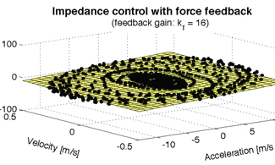
Introduction - Problem Statement
Transparency Planes
Transparency planes are three dimensional plots
Allow a comparison of the lower apparent impedance boundaries of a haptic device
Metzger et al. (2015)
Notes:
Ramon
Transparency planes are three dimensional plots allow a comparison of the lower apparent impedance boundaries of a haptic device
Every black dot represents a data triplet of in this case vel, accel and force which are recorded by moving the paddle with different accelerations and velocities
The rectangles represent the fitted transparency planes
This plane give us the apparent mass and apparent damping which are the slopes of the plane itself.
the flatter they are, the more transparent the device can behave, like the pen in free air example

Slide 5
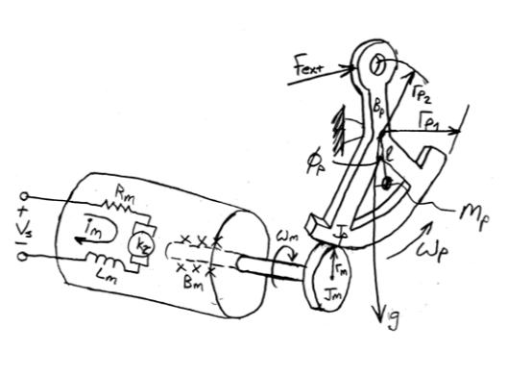
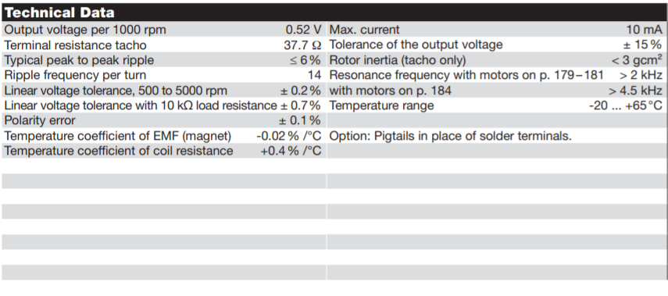
Methods - Implementation
Tachometer Characterization - Transfer Function
Datasheet Tachometer DC Tacho DCT 22 0.52 Volt
pHRI Lecture 8
Notes:
Xiaowei
These control schemes require a good velocity estimate for a smooth and stable rendering of velocity-dependent force fields and a direct measurement of the interaction force
Values on the datasheet is for the motor, we need to convert it to the paddle using the geometry relationship

Slide 6
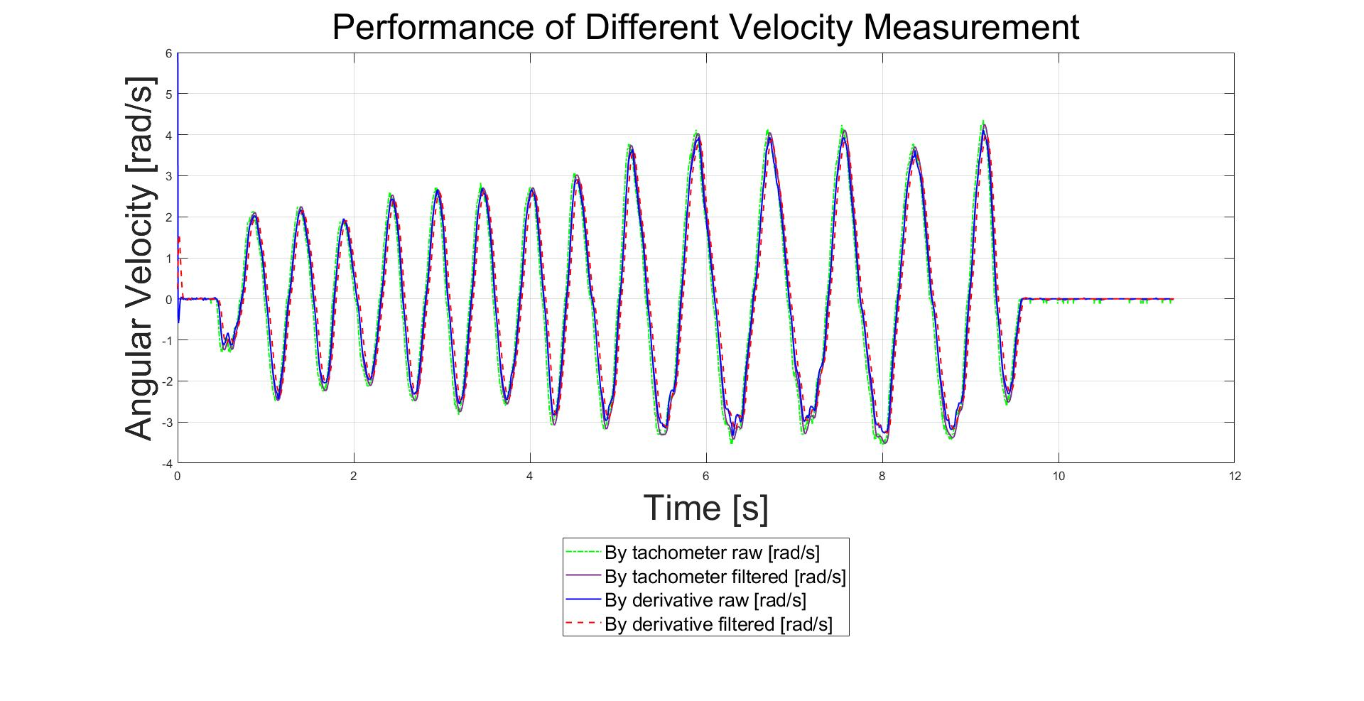
Methods - Implementation
Tachometer Characterization - Performance Comparison
Notes:
Xiaowei
We compare the performance of different velocity measurement methods.

Slide 7
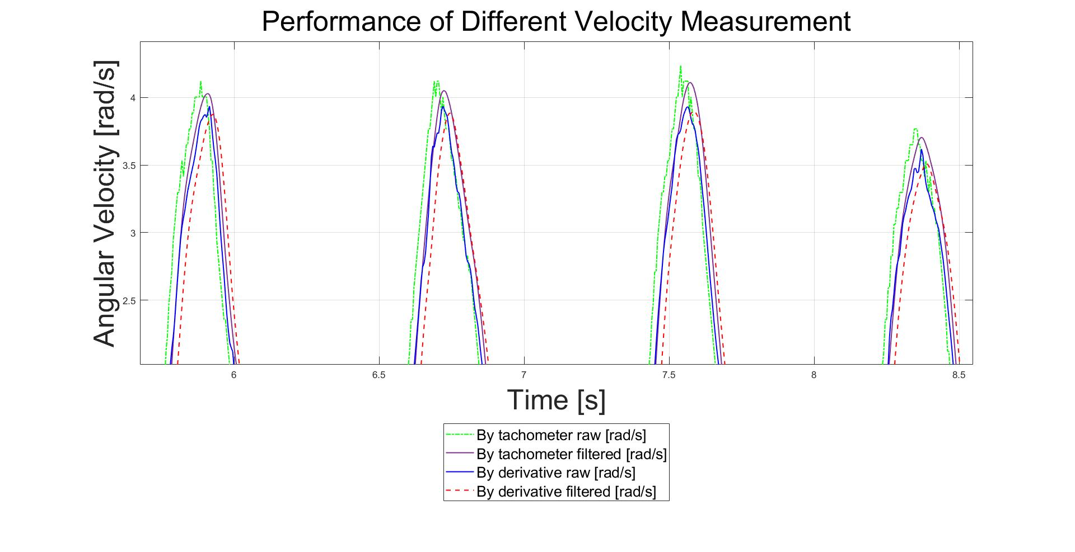
Methods - Implementation
Tachometer Characterization - Performance Comparison
Notes:
Xiaowei
Direct measurement of the velocity has get the fastest data. But noisy, after filtering, the curve is smooth and still faster than unfiltered velocity derived using derivative.

Slide 8
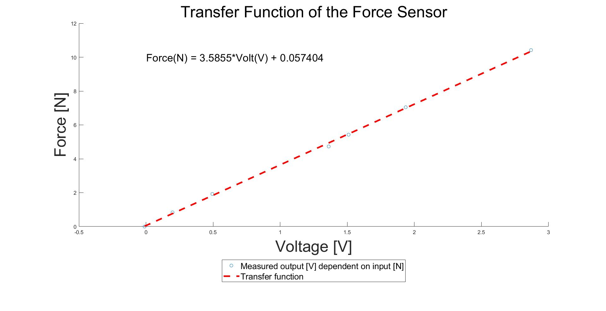
Methods - Implementation
Force Sensor Characterization
Notes:
Xiaowei
We also derived the transfer function for the force sensor
We then can use the sensors’ data to implement the impedance control with force feedback in the VI(next slide)

Slide 9
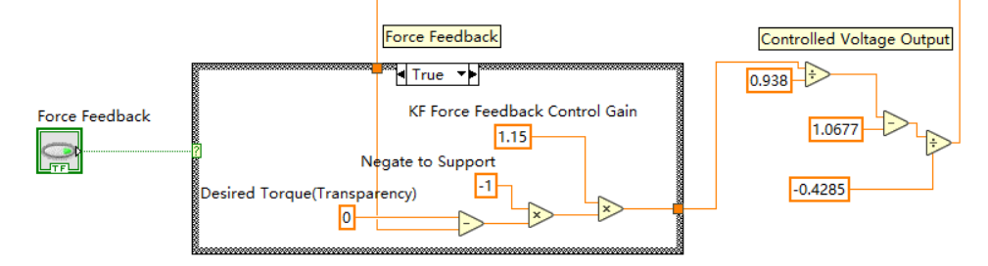
Methods - Implementation
Force Feedback Implementation in Transparency Mode
Notes:
Xiaowei
Desired torque is 0 in transparency mode

Slide 10
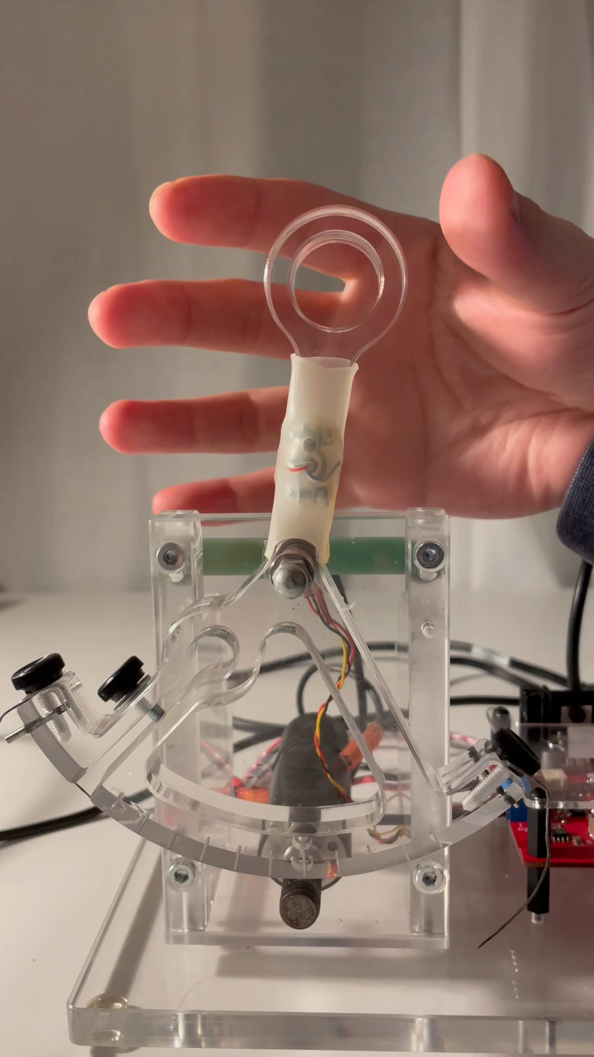
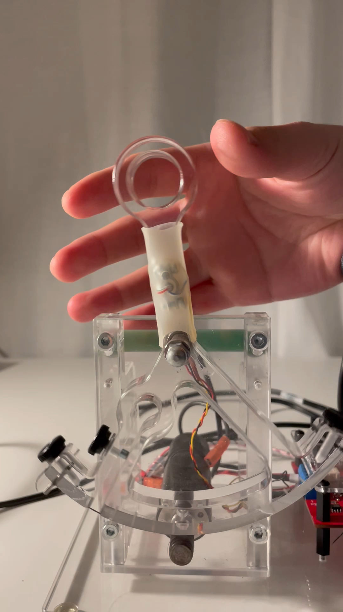
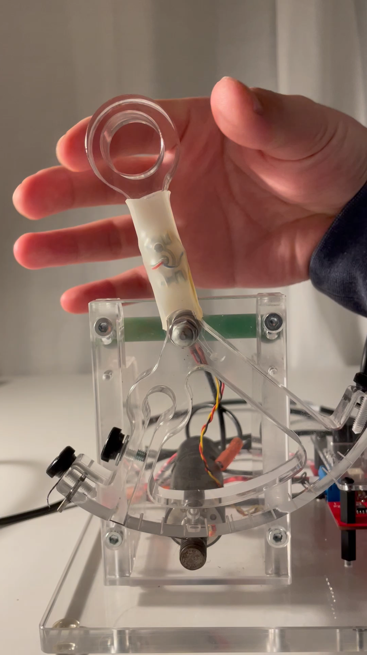
Results - Videos
Uncontrolled
Friction-Gravity Compensation
Force Feedback
Notes:
Xiaowei
Uncontrolled: hardly move the paddle by slightly hitting the handle
Friction-Gravity Compensation: smoother but a bit clumsy. It’s not perfectly compensated.
Force Feedback: Smoother than uncontrolled and lighter than Friction-Gravity Compensation

Slide 11
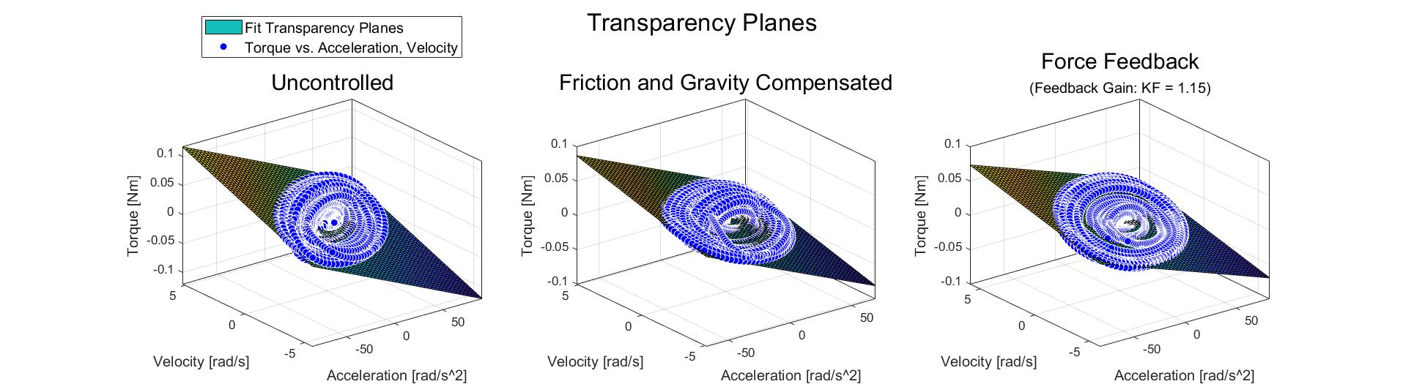
Results - Transparency Planes
 | I_app [kg*m^2] | b_app [Nm/(rad/s)] | R-square | # fitting points | Max. residual [Nm] | Avg. residual [Nm]
Uncontrolled | 0.0007852 | 0.008958 | 0.8852 | 5039 | 0.0218 | 0.0049
Friction and Gravity Compensated | 0.0008166 | 0.005411 | 0.8842 | 4224 | 0.0335 | 0.0080
Force Feedback | 0.0005468 | 0.004377 | 0.9139 | 4665 | 0.0262 | 0.0076
Control Schemes
Fitting Results
Notes:
Ramon
Here we can see the three transparency planes for all three control schemes.
This table here summarizes the fitting outcomes of the transparency planes
As you can see, apparent Inertia and damping have the lowest values for the force feedback scheme
R square, maximum residual and avg residual all refer to the goodness of the fit.

Slide 12
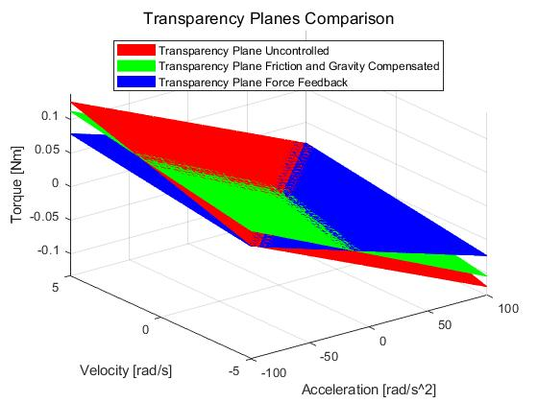
Discussion
Transparency Planes Comparison
Notes:
Ramon
For evaluation of all the three control schemes we can compare the three fitted planes with each other and discuss our results with respect to the us given literature.
On one hand as we can see clearly the blue plane, which is the force feedback plane is the flattest of the three, so the device is more transparent under force feedback condition.
On the other hand the intersection of green and red planes indicate, that there is no clear more transparent plane in the other two control schemes because the friction and gravity is not perfectly compensated even in our lab session.

Slide 13
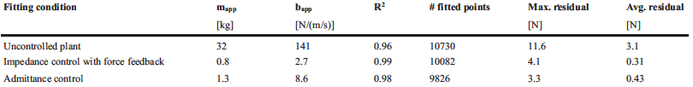
Discussion
Metzger et al. (2015)
 | I_app [kg*m^2] | b_app [Nm/(rad/s)] | R-square | # fitting points | Max. residual [Nm] | Avg. residual [Nm]
Uncontrolled | 0.0007852 | 0.008958 | 0.8852 | 5039 | 0.0218 | 0.0049
Friction and Gravity Compensated | 0.0008166 | 0.005411 | 0.8842 | 4224 | 0.0335 | 0.0080
Force Feedback | 0.0005468 | 0.004377 | 0.9139 | 4665 | 0.0262 | 0.0076
Control Schemes
Fitting Results
Notes:
Ramon
For interpretation of our results we compare them to the results of the researchers from ReLab which did a similar evaluation with the ReHabticKnob

Slide 14
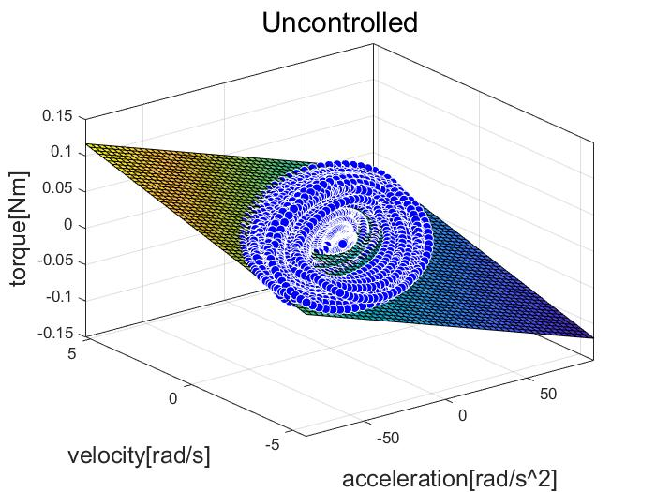
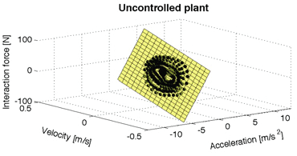
Discussion
Control Schemes
Metzger et al. (2015)
Apparent mass: 32 kg | Apparent inertia: 0.0007852 kg*m^2
Apparent dampening: 141 N/(m/s) | Apparent dampening: 0.008958 Nm/(rad/s)
Notes:
Ramon
First we compared the two uncontrolled devices.
Apparent mass and damping of the RHK is very big in comparison to the inertia and damping of the HP
That’s why the slope of the transparency plane of the RHK is much steeper in comparison to the slope of the HP with the same scheme
In the literature, Metzger and his colleagues mentioned that moving the output of the uncontrolled RHK requires forces of over 6 N
The required torques of the Haptic paddle on the other hand are quite small due to low inertia and low inherent friction.

Slide 15
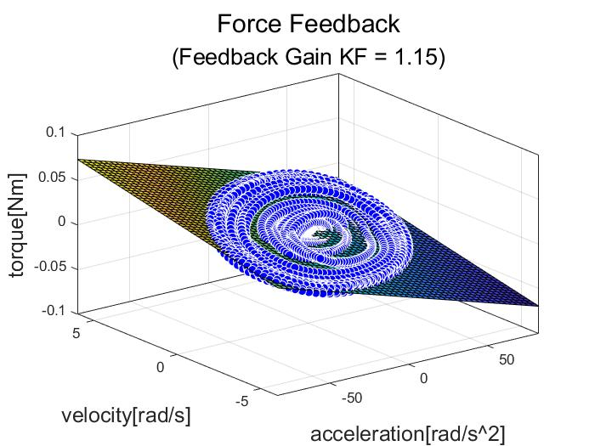
Discussion
Control Schemes
Metzger et al. (2015)
Apparent mass: 0.8 kg (32 kg uncontrolled) | Apparent inertia: 0.0005468 kg*m^2 (0.0007852 kg*m^2 uncontrolled)
Apparent dampening: 2.7 N/(m/s) (141 N/(m/s) uncontrolled) | Apparent dampening: 0.004377 Nm/(rad/s) (0.008958 Nm/(rad/s) uncontrolled)
Notes:
Ramon
We then compared the two devices with ImpC with force feedback.
Apparent mass and damping of the RHK are much smaller then the uncontrolled scheme from the previous slide.
The differences from uncontrolled to impC with force feedback for the RHK are very big
According to its low inertia and low inherent friction the differences for the HP are not that significant but we can see them.

Slide 16
Limitations
The non-linear friction and gravity we did not perfectly compensate
The inconsistent behavior of the force sensor
The right feedback gain for the force feedback
Notes:
Xiaowei
According to the results, our implementation is not perfect and has some limitations.
Nonlinear friction that we did not perfectly compensate - even in the lab section
Inconsistent behaviour of the force sensor during fast changes of the paddle’s motion, so only regular sinusoidal movement patterns do lead two desired behaviour and desired transparency planes - transparency planes tilted in different ways.
Tendency to oscillate due to overcompensation at the borders (extremes) of the ROM

Slide 17
Conclusion and Outlook
Conclusion
ImpC with force feedback does improve the performance of the haptic paddle
But not always…
Outlook
Better modeling of friction and gravity
Force sensor
Method to find the better gain for the force feedback
Notes:
Xiaowei
Impedance control with force feedback (explicit force control) does improve performance of the haptic device
The most transparent plane was achieved by the ImpC with force feedback
Outperformed uncontrolled and friction/gravity compensated plant
Not always, as discussed, the performance highly depends on the hardware
To improve
We could derive a better model of friction and gravity so that they can be better compensated
We could use a better force sensor - at least more stable
We could get suggestions from the experts on how to get a better gain for the force feedback control system so that we can better eliminate the effect of the device impedance

Slide 18
References
J.-C. Metzger, O. Lambercy, and R. Gassert, "Performance comparison of interaction control strategies on a hand rehabilitation robot," 2015 2015: IEEE, doi: 10.1109/icorr.2015.7281308. [Online]. Available: https://dx.doi.org/10.1109/icorr.2015.7281308
J.-C. Metzger, O. Lambercy, and R. Gassert, "High-fidelity rendering of virtual objects with the ReHapticKnob - novel avenues in robot-assisted rehabilitation of hand function," 2012 2012: IEEE, doi: 10.1109/haptic.2012.6183769. [Online]. Available: https://dx.doi.org/10.1109/haptic.2012.6183769
O. Lambercy, “Physical Human Robot Interaction”, Lecture Notes, ETHZ, 2021
J. Dittli, “Physical Human Robot Interaction”, Lecture Notes, ETHZ, 2021
R. Gassert, “Physical Human Robot Interaction”, Lecture Notes, ETHZ, 2020

Slide 19
Thank you for your attention!
Ramon Rohner
rarohner@student.ethz.ch
Xiaowei Lin
xiaoweilin@student.ethz.ch
Physical Human Robot Interaction Specialization Project 07
ETH Zurich
NO, Clausiusstrasse 2-30
8006 Zurich, Switzerland

Slide 20
Introduction - Problem Statement - Backup Slides
Interaction Control Scheme
Open-loop Impedance Control
Impedance Control with Model Feedforward
Notes:
Xiaowei
Block diagrams adapted from the lecture slides.
The input motion from the user is on the right.
Tau user is the torque applied by the user and also the torque felt by the user (Newton’s third law).
The input motion goes into the virtual device on the left side, which outputs the desired torque that the user should feels.

Slide 21
Introduction - Problem Statements - Backup Slides
Interaction Control Scheme
Impedance Control with Force Feedback
Notes:
Xiaowei

